Slide 1
COMP10001
Week 4
with Lucy

Slide 2
Booleans, operators and conditionals

Slide 3
What is “Boolean”? What values does it store?

Slide 4
What is “Boolean”? What values does it store?
Stores a truth value: True / False

Slide 5
What is “Boolean”? What values does it store?
What happens when we convert other types to Booleans?
Stores a truth value: True / False

Slide 6
What is “Boolean”? What values does it store?
What happens when we convert other types to Booleans?
Stores a truth value: True / False
Numbers: zero is False
Strings and lists: empty string (“”) is False

Slide 7
The following prompts are either a Boolean value, a relational operator or a logical operator. Which is which?
== |  | > |  | False
!= |  | and |  | <=
or |  | >= |  | not
True |  | <

Slide 8
The following prompts are either a Boolean value, a relational operator or a logical operator. Which is which?
== | relational | > | relational | False | Boolean
!= | relational | and | logical | <= | relational
or | logical | >= | relational | not | logical
True | Boolean | < | relational

Slide 9
How do we use an “if” statement?

Slide 10
How do we use an “if” statement?
Structure: if <condition>:
Relational and logical operators form the condition!
Indentation tells us what’s inside the “if” statement
If the condition is True:
Python completes the lines directly following the “if”

Slide 11
How do we use an “if” statement?
What are the variants of “if” statements?
Structure: if <condition>:
Relational and logical operators form the condition!
Indentation tells us what’s inside the “if” statement
If the condition is True:
Python completes the lines directly following the “if”

Slide 12
How do we use an “if” statement?
What are the variants of “if” statements?
Structure: if <condition>:
Relational and logical operators form the condition!
Indentation tells us what’s inside the “if” statement
If the condition is True:
Python completes the lines directly following the “if”
else:
elif <condition>:

Slide 13
Exercises !

Slide 14
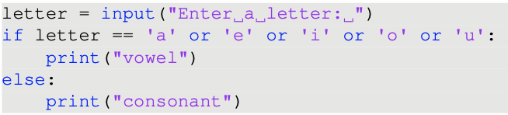
What’s wrong with this code? How can we fix it?

Slide 15
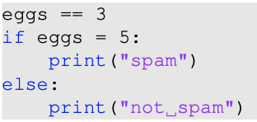
What’s wrong with this code? How can we fix it?

Slide 16
Sequences

Slide 17
What is a “sequence”? What sequences have we seen so far?

Slide 18
What is a “sequence”? What sequences have we seen so far?
A data type that stores a series of values in a specific order
Strings: sequences of characters
Lists/tuples: sequences of any object

Slide 19
What is a “sequence”? What sequences have we seen so far?
What operators can we use with sequences?
A data type that stores a series of values in a specific order
Strings: sequences of characters
Lists/tuples: sequences of any object

Slide 20
What is a “sequence”? What sequences have we seen so far?
What operators can we use with sequences?
A data type that stores a series of values in a specific order
Strings: sequences of characters
Lists/tuples: sequences of any object
+ operator: concatenate sequences
* operator: repeat sequences

Slide 21
What is indexing? How do you do it?

Slide 22
What is indexing? How do you do it?
Access an item stored at a specific location in a sequence

Slide 23
What is indexing? How do you do it?
Access an item stored at a specific location in a sequence
We index with square brackets:
sequence_name[i]

Slide 24
What is indexing? How do you do it?
Access an item stored at a specific location in a sequence
We index with square brackets:
sequence_name[i]
Indices must be integers

Slide 25
What is indexing? How do you do it?
Access an item stored at a specific location in a sequence
We index with square brackets:
sequence_name[i]
Indices must be integers
Positive integers count forwards from zero
Negative integers count backwards

Slide 26
What is slicing? How do you do it?

Slide 27
What is slicing? How do you do it?
Access several items stored in a subsection of a sequence

Slide 28
What is slicing? How do you do it?
Access several items stored in a subsection of a sequence
We slice with square brackets and a colon:
sequence_name[from:to]

Slide 29
What is slicing? How do you do it?
Access several items stored in a subsection of a sequence
We slice with square brackets and a colon:
sequence_name[from:to]
Indices must be integers
Items are taken from from up to one item before to

Slide 30
What is slicing? How do you do it?
Access several items stored in a subsection of a sequence
We slice with square brackets and a colon:
sequence_name[from:to]
Indices must be integers
Items are taken from from up to one item before to
How about step sizes?

Slide 31
What is slicing? How do you do it?
Access several items stored in a subsection of a sequence
We slice with square brackets and a colon:
sequence_name[from:to]
Indices must be integers
Items are taken from from up to one item before to
How about step sizes?
sequence_name[from:to:step_size]

Slide 32
What is slicing? How do you do it?
Access several items stored in a subsection of a sequence
We slice with square brackets and a colon:
sequence_name[from:to]
Indices must be integers
Items are taken from from up to one item before to
How about step sizes?
sequence_name[from:to:step_size]
A negative step_size takes a backwards slice!

Slide 33
More exercises!

Slide 34
Functions

Slide 35
What is a “function”? How do we call (use) one? How do we define one?

Slide 36
What is a “function”? How do we call (use) one? How do we define one?
A block of reusable code, defined once and reusable wherever we would like!
print(), input(), int(), len() are all built-in functions we’ve already met!

Slide 37
What is a “function”? How do we call (use) one? How do we define one?
A block of reusable code, defined once and reusable wherever we would like!
print(), input(), int(), len() are all built-in functions we’ve already met!
To call a function, we need brackets:
function_name(function_arguments, …)

Slide 38
What is a “function”? How do we call (use) one? How do we define one?
A block of reusable code, defined once and reusable wherever we would like!
print(), input(), int(), len() are all built-in functions we’ve already met!
To call a function, we need brackets:
function_name(function_arguments, …)
To define a function, we need def:
def function_name(function_argument_names, …):
[function guts go here!]

Slide 39
What does it mean when a function “returns” something?
Notes:
Why would we want to return something? Does a function always need a return value?

Slide 40
What does it mean when a function “returns” something?
The return value is available to the line of code where the function was called
That means we can assign it to a variable!
A function doesn’t need a return value
e.g. functions that do something, like print()
Notes:
Why would we want to return something? Does a function always need a return value?

Slide 41
What’s so great about functions?

Slide 42
What’s so great about functions?
Functions save time avoiding duplicated code!
Code is shorter
Code is easier to read
Code is easier to edit
Code is easier to reapply to other problems

Slide 43
Why are brackets important when calling a function?

Slide 44
Why are brackets important when calling a function?
Brackets are the difference between referencing a function’s name and calling the function
We still need brackets, even if they’re going to be empty!

Slide 45
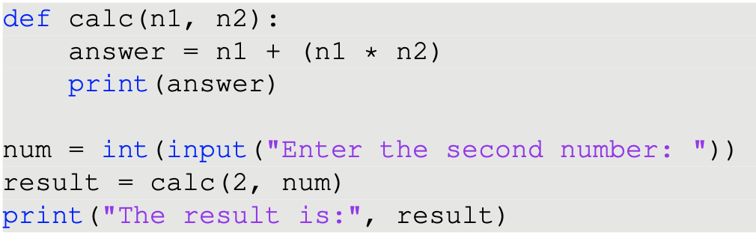
A quick exercise!
What’s wrong with this code? How can we fix it?

Slide 46
Coding problem 1
Write a function which asks the user for their name and returns a shortened version of the string consisting of the name’s first three letters and then every second letter in the rest of the name.

Slide 47
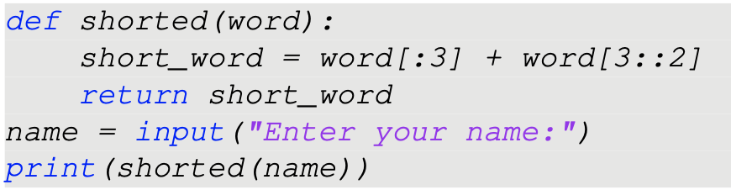
Coding problem 1
Write a function which asks the user for their name and returns a shortened version of the string consisting of the name’s first three letters and then every second letter in the rest of the name.

Slide 48
Coding problem 1
Write a function which asks the user for their name and returns a shortened version of the string consisting of the name’s first three letters and then every second letter in the rest of the name.

Slide 49
Coding problem 2
Write a function which takes a sentence as a single argument (in the form of a string), and evaluates whether it is valid based on whether the first letter is capitalised and the last character is a full stop. Return a Boolean value True or False.

Slide 50
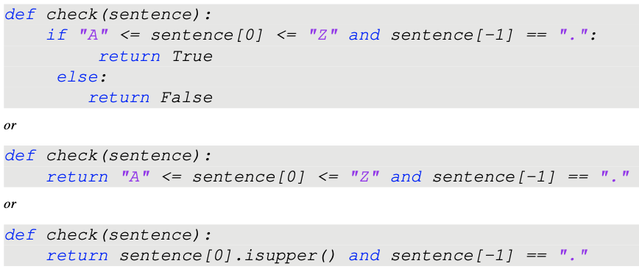
Coding problem 2
Write a function which takes a sentence as a single argument (in the form of a string), and evaluates whether it is valid based on whether the first letter is capitalised and the last character is a full stop. Return a Boolean value True or False.

Slide 51
Coding problem 3
Write a program which asks the user for two numbers and an operator (either +, -, * or /) and performs that operation on the two numbers, printing the result

Slide 52
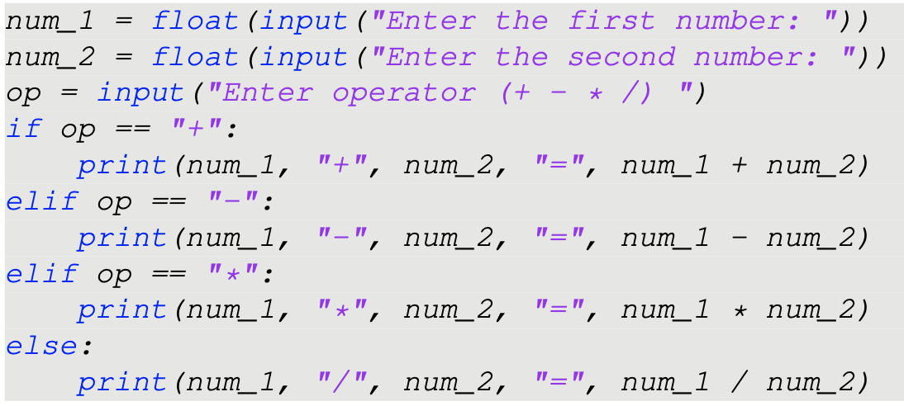
Coding problem 3
Write a program which asks the user for two numbers and an operator (either +, -, * or /) and performs that operation on the two numbers, printing the result

Slide 53
Coding problem 3
Write a program which asks the user for two numbers and an operator (either +, -, * or /) and performs that operation on the two numbers, printing the result

